Slide 1
CDBG Limited Clientele Activities
Wausau, Wisconsin

Slide 2
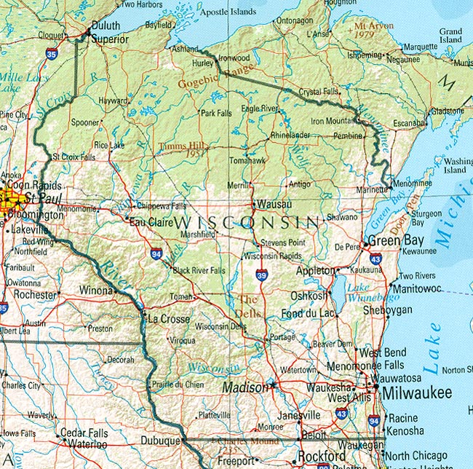
Where is Wausau?
Located in Central Wisconsin
Population just under 40,000*
*The principal city of a Metropolitan Statistical Area

Slide 3
Wausau’s CDBG Statistics
Over the past 4 years, Wausau’s allocations have ranged from $597,000 to $647,000. 2024’s allocation is $600,224.
Public Service Activities receive 10-15% of the annual allocation, up to a max of $97,000/yr. The 2024, allocation is $90,000.
Wausau typically funds between 3 – 5 Public Service Activities each year
Internal Public Facilities receive annual funding, with the possibility of securing funding for an external Public Facility as well.

Slide 4
National Objectives…
Are Met if The Activity Meets 1 of 4 Subcategories:
Area Benefit Activity
Housing Activities
Job Creation or Retention
Limited Clientele Activities
24 CFR 570.208(a)

Slide 5
Limited Clientele Activities 570.208(a)(2)
Activities that are eligible because they are designated to benefit a limited number of persons, and those benefits are either documented or presumed to be income eligible.
Documentation on File Must Show Beneficiaries Are Under HUD’s Income Limits.
Clientele falls under a HUD presumed category.

Slide 6
Types of Activities Needing Documentation
Childcare Center
To pay the salary of the employee(s) and/or administration performing work for the activity.
Food Pantry
Unless the pantry only serves one of the presumed categories.
Job Training
To pay the salary of person(s) providing the training.
Public Facility
To pay for playground equipment.

Slide 7
Sources of Documentation
Income Taxes for Household
Paystubs, Social Security Award Letter, etc.
OR
Self-Certification
Remember!!!
51% of clients MUST Fall Under HUD’s Income Guidelines
70% of clients MUST be in the Entitlement Community (or stricter)

Slide 8
Statistically, Presumed Eligible Categories
Abused Children
Battered Spouses
Elderly
Persons
Severely Disabled
Adults
Homeless Persons
Illiterate
Adults
Persons Living with AIDS
Migrant
Farm
Workers

Slide 9
Documentation
Written proof of how the determination was made and for which category.
A Grantee still needs to report in IDIS the number of beneficiaries and their income level, race and ethnicity. How should a Subrecipient document this information?
100% of beneficiaries are presumed eligible BUT what if some or all don’t live in the entitlement community? Is there a minimum number of beneficiaries who must live in the there? How should it be documented?

Slide 10
It's Never Easy
Wausau Childcare
Less than 51% of Beneficiaries met the Low- Moderate-Income requirement.
Neighbor’s Place Food Pantry
How should income levels and residency be documented for Beneficiaries?
Big Brothers, Big Sisters
How should a Non-Profit Subrecipient document Beneficiaries?
Senior Living Facility
Replacement of antiquated elevator in center which removes an architectural barrier. Senior residents are a presumed eligible population, but the center has been unable to raise additional funds to complete the project.
Bridge Clinic Community Gardens
Documentation of Beneficiaries utilizing the gardens and raising additional funds to finish the garden infrastructure after we spent our funds.

Slide 11
Best Practices
Work with your Subrecipients ahead of time to make sure qualified beneficiaries are being assisted and documenting properly
Quarterly Reports indicate if there are problems that need to be addressed prior to close out (Grantee can establish reporting
Monitor
Document, Document, Document
Even if you DON’T think you need it, Document!

Slide 12
Questions? Tammy Stratz Community Development Manager City of Wausau 715-261-6682 tammy.stratz@ci.wausau.wi.us

